Slide 1

Food safety / Food security
Kigali, Monday 16/11
Sabine Laruelle
Vice President B2I Euro Consultants Group

Slide 2

1
Feeding 9 billion in 2050

Slide 3

9 billion in 2050 = 60% increase food demand
Climate change
increased competition for soil, water, natural ressources, bio diversity
=> Agriculture = participates to climate change
= suffers the consequences
BUT : Agriculture and agro food sector are definitely the core of the solution

Slide 4
“Food security exists when all people, at all times, have access to
sufficient, safe and nutritious food to meet their dietary needs and food
preferences for an active and healthy life.” J. Diouf – FAO
“Food safety is defined as the assurance that the food will not cause harm to the consumer when it is prepared and/or eaten according to its intended use” (FAO/WHO, 1997)

Slide 5

2
Euro Consultants Group

Slide 6
An international Group :
:
  9 Countries : Belgium, France, Bulgaria, Romania, Poland, Canada, Tunisia, Marocco, Ivory Coast
  12 subsidiaries
  120 employees
An annual growth of 20% since more than 15 years

Slide 7
B2B :1990
B2B : 2000
Partnership BBA : 2015
B2I :
SME, access to market, quality (management, process, HR,…), IFS,…
Food Chain, Food security/safety, trainings, HACCP, …
BBA :
Bank and financial sector, access to finance for SME’s,…

Slide 8
Some examples :
BTSF : 14.000.000 € (2009-2017), training sessions for more than 4.000 civil servants in Europe (HACCP, feed and contaminants, food testing,…)
PCAM : 6.000.000 € (11/11-09-15), 8.000 man-days in Tunisia
Date palm : 6.370.000 € (09/10-01/14), 7.400 man-days in Morocco

Slide 9

3
Our vision

Slide 10
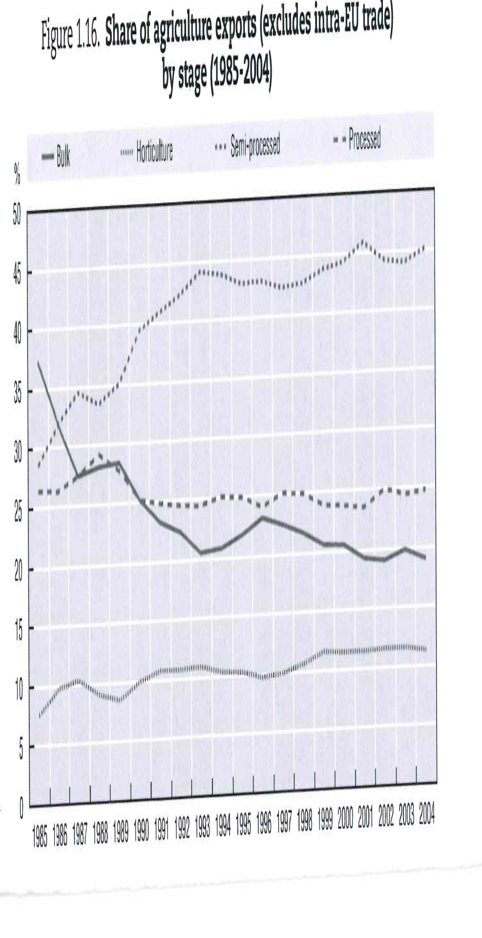
Raws products versus processed products
“Among the agricultural goods traded internationally, food products make up almost 80 per cent of the total. The other main category of agricultural products is raw materials. Since the mid-1980s, trade in processed and other high value agricultural products has been expanding much faster than trade in the basic primary products such as cereals.” WTO
OECD-FAO Agricultural Outlook
2007-2016

Slide 11
Agro food chain for a sustainable and inclusive development:
-increase the added value in each country
-increase and improve the processed food products (not only production of raw materials)
-increase the productivity
-improve access to market (local, regional, international)
-…
=> reconcile producers, downstream (processing, distribution, logistic) and upstream (supply sector) economic operators and the financial institutions

Slide 12
holistic approach
in a
Public Private Partnership

Slide 13
Value chain development : levels of interventions
-Access to finance : FIGA
-viable and sustainable actors
-production growth (processed products and raws materials)
-equity and proximity in software creating added value
-traceability and transparency (prices formation)
-quality and certification
-adaptation to the differents markets

Slide 14
Primary production (quality & waste loss reduction)
  Strengthening of peasant producers
  Technical assistance
  Standards concerning the quality of the products
  Farms sustainability

Slide 15
Logistics (post harvest) losses & lack of quality
  Capacities strengthening
  Standardization of post-harvest processes
  Products conformity with standards (audits & controls)
  Logistics, storage, cold chain, packaging optimization
  Operational management

Slide 16
Processing & adding value
  Training
  Optimization of processing & packaging
  Processes standardization & certification
  Operational management
  Quality Audits & Controls

Slide 17
Access to markets (local, regional, international)
  Strategic and operational marketing
  Branding
  Labeling
  Marketing (conclusion of contracts)
  Distribution
  Hotels - restaurants

Slide 18

4
FIGA :
Access to finance for SME’s

Slide 19
FIGA (Fonds d’Impulsion économique, de Garantie et d’Accompagnement)
Support to private sector – A global approach
Access to finance
Partnership with commercial banks
Co-financing
Strengthening own funds via subordinate loans
Guarantee Fund
Guarantee for supplementary calls
Coaching MSME
Pre creation
Strategic & operationnal aspects
Financiel aspects
Post creation
Strategic & operationnal aspects
Financiel aspects
Structuration / validation
- Business plan
- Financial plan
MPME
- Risk sharing
- Sustainability
- Increasing of the growth

Slide 20
Example (20% own funds)
Investment plan 100 000 $
Own funds 20 000 $
Subordinated loan 40 000 $
Bank credit 40 000 $
100 000 $
Banking risk after cover of the
Garantee fund – 50% of the bank 20 000 $
credit
=
50%

Slide 21

5
Food
Safety /
Security
in Belgium

Slide 22
Belgian agro food industry (2014) :
-39 billion turnover per year
-18% of industrial employment
-one of the few sectors where employment has increased or stabilized during the crisis
-investment : +12% (or 1,3 billion €)
-export : + 12,5%
-Belgium is the second European Country in term of food production (per inhabitant)

Slide 23
Federal Agency for the Safety of the Food Chain:
Origin : dioxine crisis 1999
  Consumers distrust
  Critics from officials
  Embargo on the export
  Major economical impacts : destruction, blocages, image of Belgian Food

Slide 24
Federal Agency for the Safety of the Food Chain:
=>Grouping of responsibilities product standards = FPS Public Health
=>Grouping of 6 control services of the Ministry of Agriculture and Public Health
FASFC:
-Operational standards
- Separate control policy from control (2 DG)
- Independent Scientific Evaluation of Risks (Scientific Committee)
=>Emphasis on the Safety of the whole food chain (compliance with minimum hygiene requirements, implementation of procedures based on HACCP, self checking promotion,...)
=>Consumer= central place

Slide 25
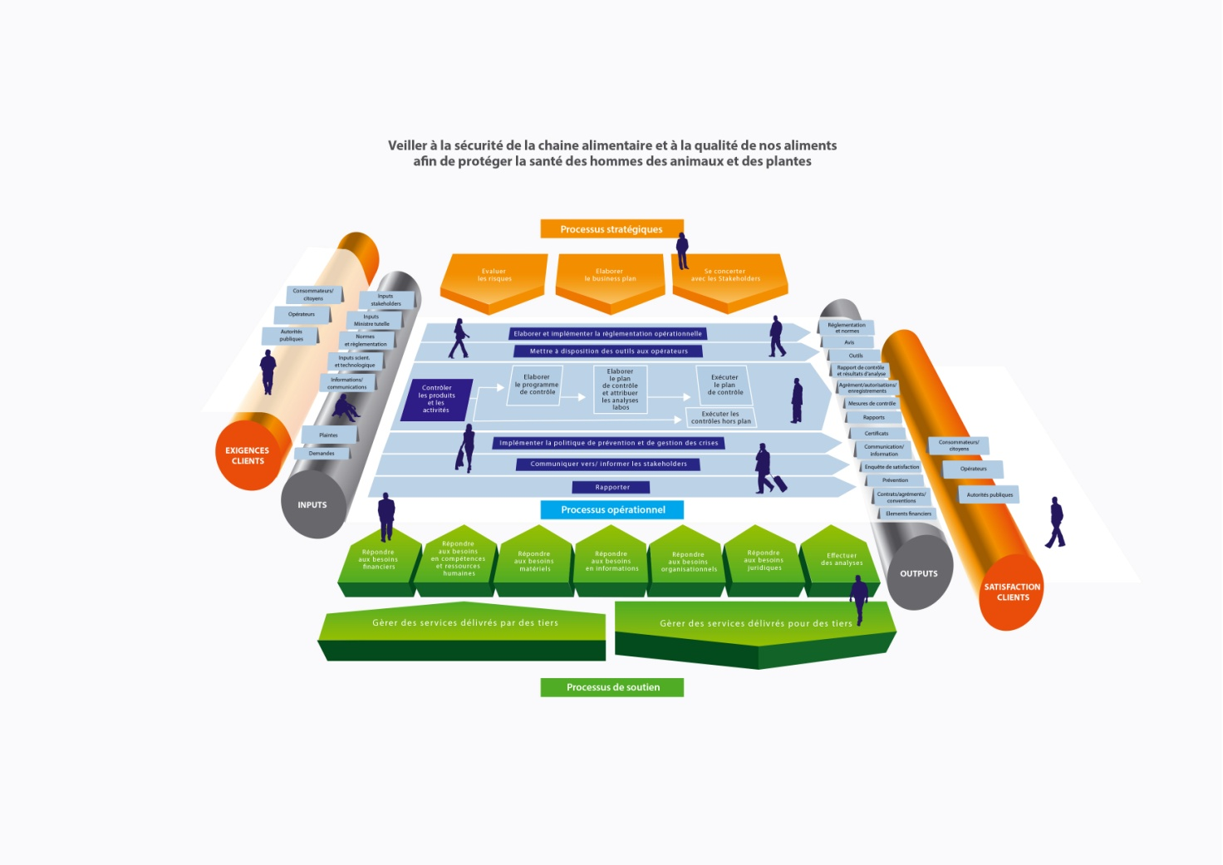
A new process model for the FASFC
End to End processes

Slide 26

6
Conclusions

Slide 27
International norms : brake or opportunity ?
-codex
-Haccp, iso, brc, ifs,…
=> collaboration between FAO and WTO
“Other areas where the two organizations are seeking to reinforce their joint efforts include the Standards and Trade Development Facility (STDF), capacity development initiatives to assist countries in the implementation of the Codex Alimentarius or "Food Code"which develops harmonized international food standards that protect consumer health and promote fair practices in food trade, and country level assistance to facilitate trade in safe and nutritious food.” WTO Director-General Roberto Azevêdo (left) and FAO Director-General José Graziano da Silva 02/11/2015

