Slide 1

Economic mission
Rwanda – Ethiopia - Kenya
Frédéric LERNOUX – CEO

Slide 2
Agenda
Belgian Bankers Academy
Public measures sustaining the internationalization of SMEs
Focus : Delcredere – Ducroire
Question time

Slide 3
BBA
Belgian Bankers Academy is a non-profit organization that supports the banking, financial and insurance sectors, including the microfinance sector, both in Belgium and abroad
BBA’s activities are divided into four business lines: Audit and Consultancy - Training - Banking Simulations – Private sector
BBA can rely on its expertise, and capitalises on its experience when intervening in projects designed to install tools encouraging the creation and development of small and medium-sized enterprises and ensuring their management

Slide 4
Experience …
Algeria
Angola
- Azerbaijan
- Bulgaria
- Burundi
Canada
- China
- Congo-Brazzaville
- Croatia
- Czech Republic
- Denmark
- Egypt
- Ethiopia
- Estonia
- France
- Georgia
- Germany
- Greece
- Hungary
- Indonésia
Italy
- Ivory Coast
- Jordan
- Kenya
Kosovo
- Kuwait
- Latvia
- Lebanon
- Lesotho
- Lithuania
- Luxembourg
- Malaysia
- Moldova
- Montenegro
- Morocco
- Mozambique
- The Netherlands
- Nigeria
- Poland
- Portugal
- Romania
- Russia
- Rwanda
- Senegal
- Singapore
- Slovak Republic
- South Africa
- Syria
- Tanzania
- Thailand
- Tunesia
- Turkey
- Turkmenistan
- Uganda
- Ukraine
- United States
- Vietnam
- Yemen
- Zimbabwe

Slide 5



















BBA in Subsaharian Africa
www.bbacademy.be for more details

Slide 6
Public measures sustaining the internationalization of SMEs
  AWEX
  BIE
  FIT
  FINEXPO
  SBI/BMI
  BIO
  Delcredere - Ducroire

Slide 7
DELCREDERE - DUCROIRE
Belgium's public credit insurer, covering companies and banks against political and commercial risks relating to international commercial transactions
Insurance Products
Financial Guarantees
Direct Financing

Slide 8
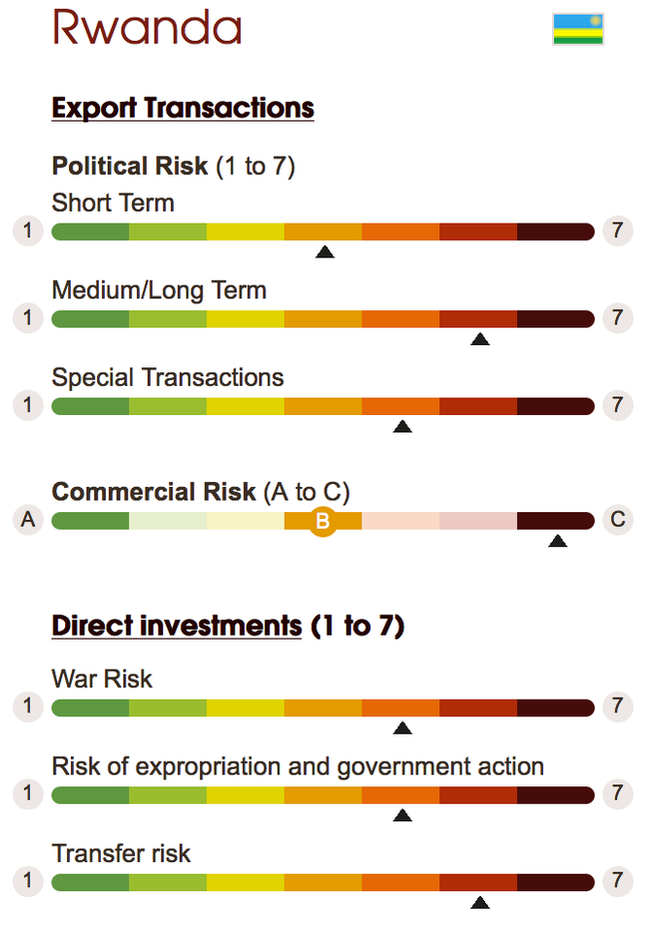
Risk - Rwanda

Slide 9
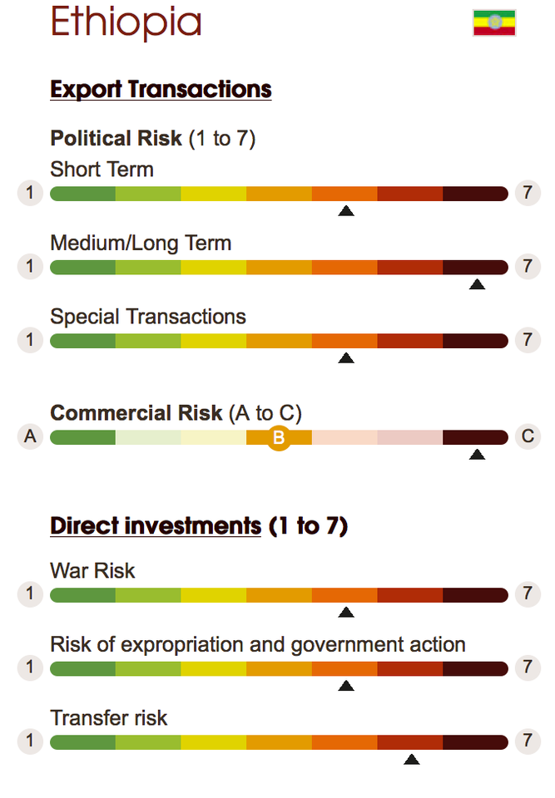
Risk - Ethiopia

Slide 10
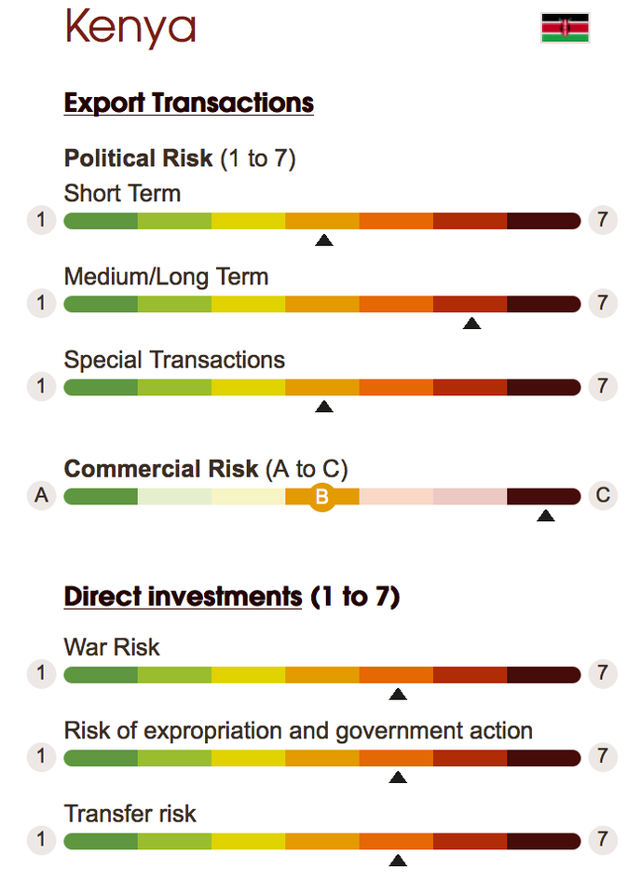
Risk

Slide 11
Q & A
Frédéric Lernoux – CEO
Join my LinkedIn network http://be.linkedin.com/in/fredericlernoux
www.bbacademy.be
info@bbacademy.be

