Slide 1

Infrastructure Investment Outlook
Ministry of Infrastructure
The Republic of Rwanda

Slide 2
Risk Mitigation | Bilateral Investment Treaty with the United States
Rwanda Development Board | Open 24 Hours
S & P Country Credit Rating | B with a Stable Outlook
Fitch Competitiveness Rating | B with a Stable Outlook
Best Global Reformer Since 2005 | World Bank Doing Business 2014
2nd Most Competitive Place to Do Business in Africa | World Bank Doing Business 2014
Positioned 32nd out of 185 Countries | World Bank Doing Business 2014
Guiding Planning Documents| EDPRS II, 7 years Government Program, Millennium Targets
Cabinet Performance Contracts | Imihigo
Rwanda | Unique Propositions

Slide 3
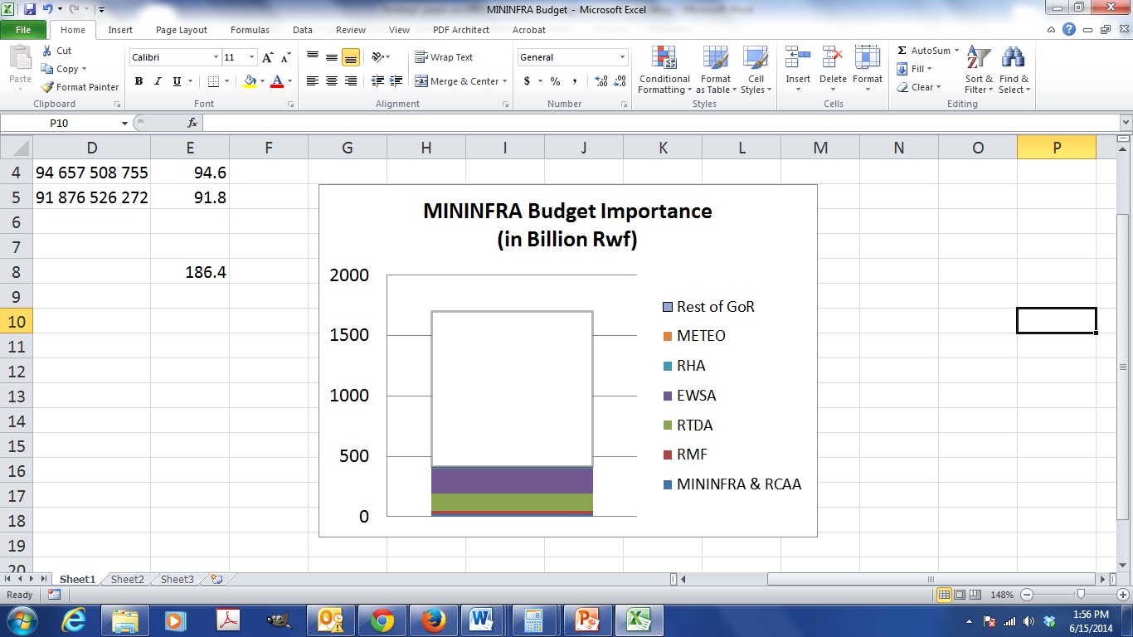
Importance of the Infrastructure Sector
MININFRA represents roughly 25% national budget
Large Annual Budget | 412 Bn RwF/
(45% externally financed)
Supporting other sectors | Service infrastructure
Driving private sector growth | >80% new projects in Energy undertaken by private sector
Multiple Investment Opportunities | Aviation, Road, Rail, and Water Transport, Energy, Water and Sanitation, Housing and Construction

Slide 4
Progress and key statistics and Targets
Roads:
The National Paved Road Network is currently of 1210 Km.
The target is to pave around 500 Km more in the coming years (up to 2018)
It is has started with Kivu Belt project (158 Km of new tarmac road).
Also a great care is provided for the maintenance of the paved national road network with currently 86% of roads in good condition with a target of 95% in 2017-18.
Air Transport:
The Kigali International Airport terminal has recently been upgraded.
Kamembe Airport (Rusizi) Runway will be resurfaced this fiscal year.
Project of New Bugesera International Airport is progressing with expropriation completed this year.
Rwandair is growing and expanding with more aircrafts with a target of 20% more passenger in the coming year and opening of new destinations.
Regional Projects:
Railway Line Projects of Dar-Es-Salaam Isaka Kigali and Mombasa-Nairobi-Kampala-Kigali.
Investment Facilitation
Develop more PPP projects like NBIA and potential roads (like Ring Road)
Transport Sector

Slide 5
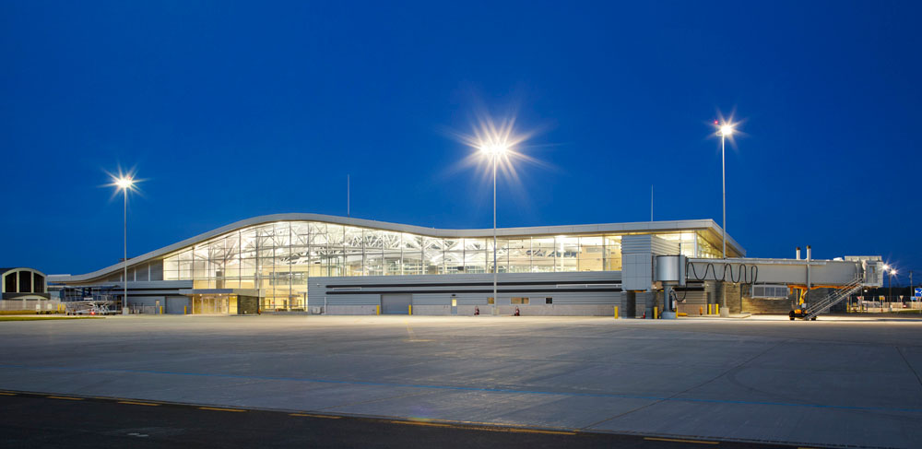
Value of Project
USD 700 million
Incentives
Site available.
Activities
Feasibility study
Underway – Lufthansa
Requirements
Partner with investor to build the airport.
Transport Sector: Investments
Bugesera International Airport

Slide 6
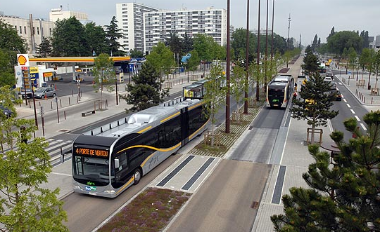
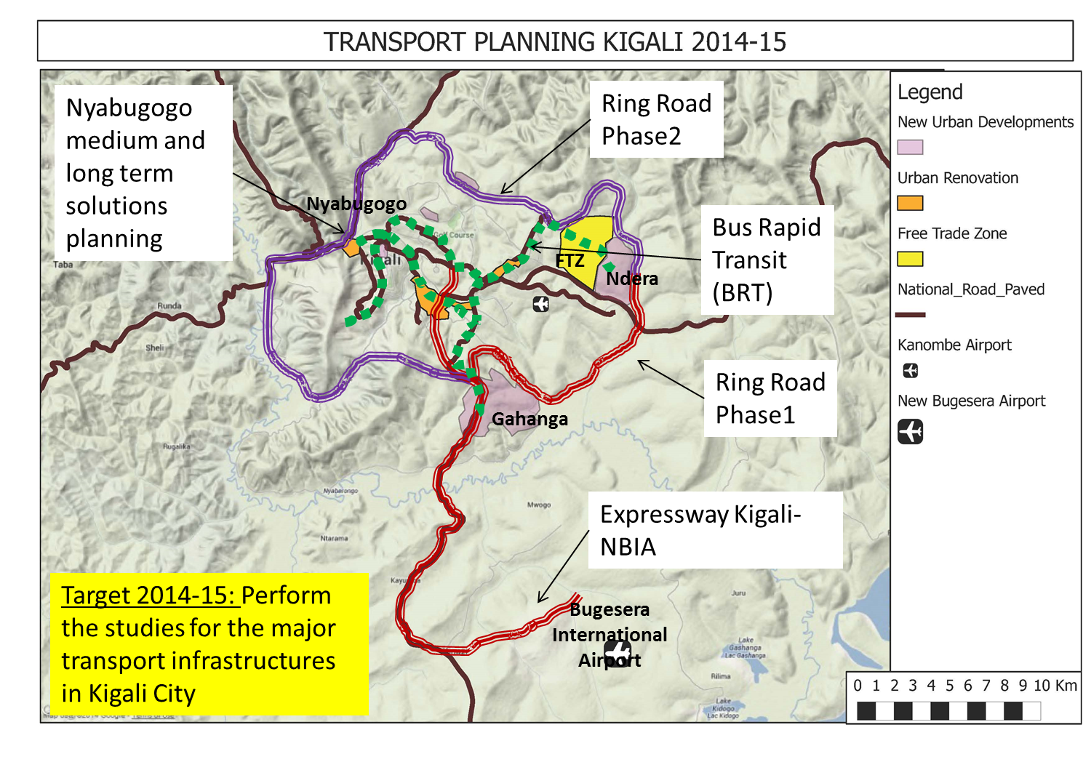
Feasibility Study Required
Bus Rapid Transport Lines (BRT) for Kigali City
Value of projects: USD 391m
Incentives:
Project to develop a modern mass public transport system included in Kigali City Master Plan
2 Phases: 1st Phase North-East to West, 2nd Phase South to West (40km in total)
Way forward:
Conduct feasibility studies, detailed design and secure funding
Ring Roads for Kigali City
Feasibility Study Required
Value of projects: USD 240m
Incentives:
80km of ring roads identified to increase mobility and reduce traffic congestion.
2 Phases: 1st Phase East to South section, 2nd Phase connecting 1st Phase from South around Kigali to Eastern section.
Project provided in the Kigali City Master Plan
Detailed study to be carried out 2014/15
Way forward:
Perform studies and secure funding
Proposed model: PPP with toll-road system

Slide 7
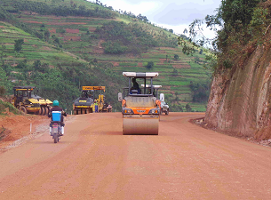
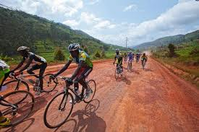
Feasibility Study Required
Bypass roads in 5 priority cities
Value of projects: USD 177m
Incentives:
Rubavu, Huye, Muhanga, Musanze and Rusizi cities selected
All feasibility studies to be completed by 2015
Detailed study to be completed by 2016
Way forward:
Perform studies and secure funding
Express way to Bugesera Airport
Value of projects: USD 100m
Feasibility Study Required
Incentives:
A 40km transport link between the new airport and Kigali City
Road to be 4 lanes (2x2). Potential to construct airport roads as well
Detailed study to be completed 2014/2015
Way forward:
Perform studies and secure funding
Huye-Kibeho-Ngoma Road
Value of projects: USD 80m
Incentives:
A 68km transport corridor linking Southern tourism areas
Detailed study has been completed
Way forward:
Project expected to be completed by 2015

Slide 8
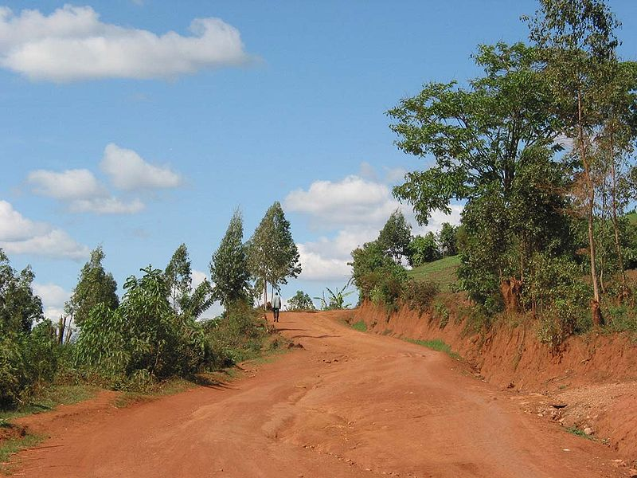
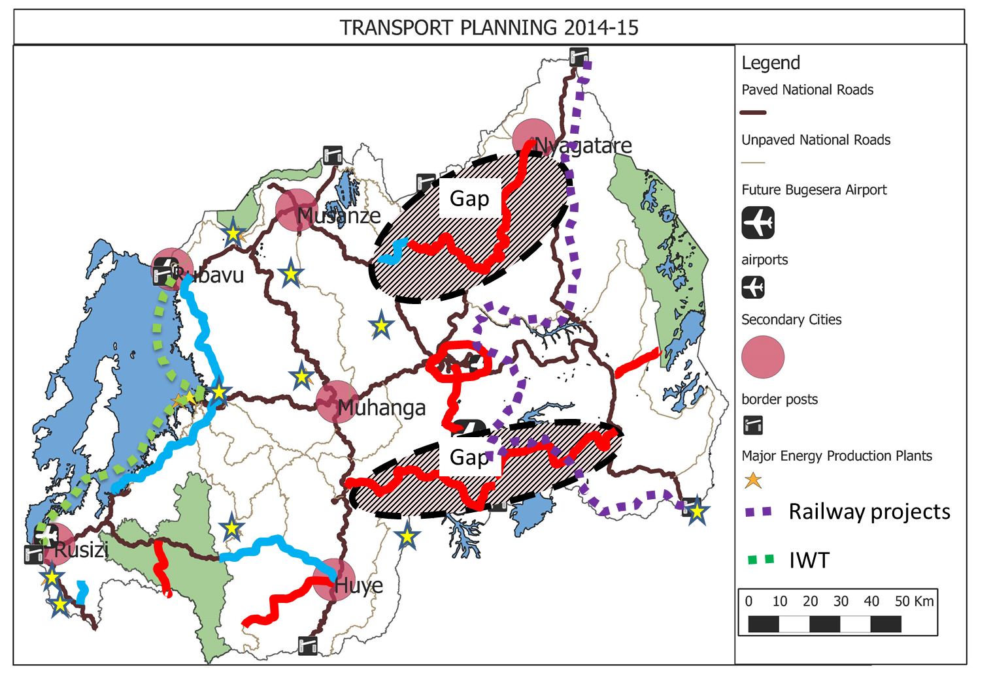
Ngoma-Bugesera-Nyanza Road
Value of projects: USD 177m
Incentives:
A 130km transport link between Southern and Eastern Provinces
Feasibility study has been completed (December 2013)
Detailed study to be completed by 2015
Way forward:
Project is to be completed by 2017
Feasibility Study Required
Base-Gicumbi-Nyagatare Road
Value of projects: USD 194 m
Incentives:
A key 125km Regional Transport corridor connecting Uganda to Congo, which by-passes Kigali. Located between Northern and Eastern Provinces.
Detailed designs completed
Way forward:
Project is to be completed by 2017

Slide 9
Energy Sector
Progress and Key statistics
Increase in electricity connections: From 6% in 2008 to 22% August 2014
Steady increase in generation: 119.6MW August 2014
Electricity Generation: 59% Hydro, 40% Thermal, 1% Methane and other.
Regional generation: Hydro power, geothermal exploration
Regional interconnections: Developing Uganda-Kenya-Ethiopia lines
Biomass consumption: Reduced form 99% population in 2000 to 85% in 2013
Schools and health clinics with electricity access: 64% and 100%
CFL Distribution: 800,000 distributed
Average tariffs: $0.22c/KwH for industry and $0.21c for other consumers
Targets to be met by 2018
Electricity Access: 70% households
Grid capacity (domestic + imports): 563MW
Regional Connections: Uganda and Kenya 2016, Ethiopia 2017
Biomass consumption: 85% to 50%
Schools and health centres: 100%
Investment Facilitation
Power Purchase Agreements (PPAs): 25 years as minimum
Independent Power Purchase Agreements (IPPs) as standard
Public Private Partnership (PPPs) experience: Draft PPP Law and Policy
Renewable Energy Feed-in-Tariff (REFIT): For hydro 50KW to 10MW
Long use of Engineering, Procurement and Construction (EPC)

Slide 10
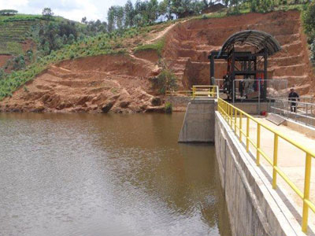
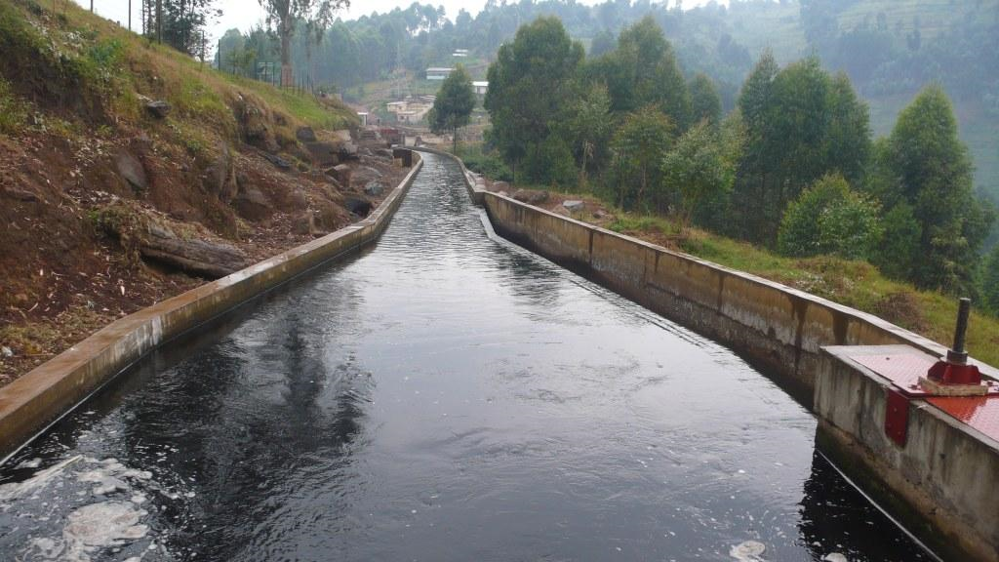
Energy Sector: Investments
Hydro Power
Value of projects: USD 350m
Incentives:
Over 333 Micro Hydropower sites have been identified
Feasibility studies complete for over 40 sites
REFIT Feed in tariff (from 50kW to 10MW)
Standard PPA for small sites
Way Forward:
Projects with feasibility studies to undergo competitive process on a periodic basis
Sample Opportunity: Hydro Power Rollout Program
Value of projects: USD 173m
Incentives:
10 hydropower sites with total installed capacity of 50MW
1 brown field ($22m), 9 green field ($160m) and 2 separate Dams at Rukarara ($13m)
On green sites: 8 pre-feasibility studies complete, 4 further studies on-going.
Way forward:
Competitive process for PPA.

Slide 11
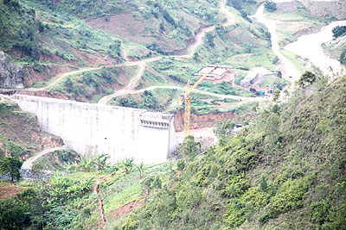
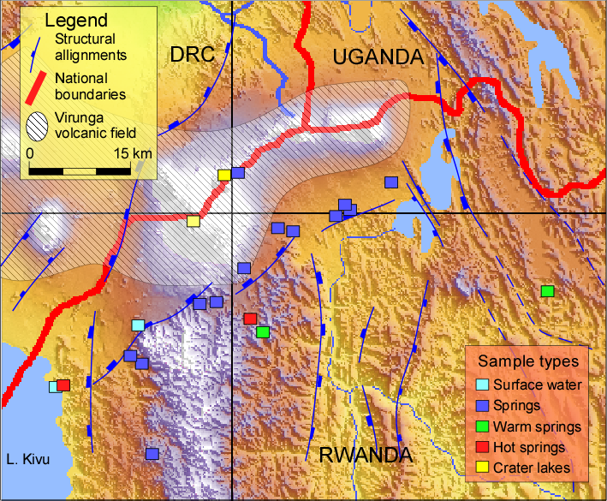
Feasibility Study On-going
Nyabarongo II
Value of projects: USD $150m
Incentives:
17 MW multi-purpose project: Phase 1 Generation, Phase 2 Irrigation and other uses
Strategic importance: energy, water supply, irrigation, flood control
Way forward:
Completion of Feasibility Study
Competitive process for BOT
Feasibility Study On-going
Geothermal Power Generation
Value of projects: USD 400m
Incentives:
350 MW of geothermal generation estimated across 4-prospects
Exploratory drilling completed at two wells
Geothermal Master Plan being developed, ready by February 2015
Way forward:
Utilise Geothermal Master Plan
Further studies to be carried out under project Scoping Phase

Slide 12
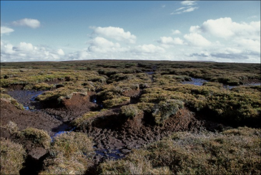
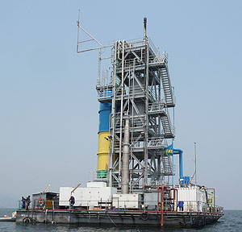
Feasibility Study Required
Peat power Generation
Value of projects: Estimated at USD 3m per MW
ex) On-going projects of 80MW valued at USD 220m
Incentives:
Nationwide peat assessment exists indicating around 600MW of potential and currently being updated
Seeking investors in both peat mining, or power generation or both
Way forward:
Further feasibility studies
Feasibility Study Required
Methane power Generation
Value of projects: TBC by capacity and availability after exploration
Incentives:
Around 350 MW of methane potential in Lake Kivu; 200 MW still available for investment
2 proof of concept sites projects been successfully established
Clear management prescriptions on safe operation and maintaining our resource established
Way forward:
Expressions of interest invited.

Slide 13
Water & Sanitation Sector
Progress and Statistics:
Rwanda is being used as case study for all of Africa due to its success in water & sanitation
Abundant supply of lakes and high altitude water
Access to clean water: 74% by 2010
Sanitation coverage: 74.5% by 2011
Waterless Latrine coverage: 92% by 2011
Targets for 2018:
Access to clean water: 100%
Rural water supply infrastructure with 100% functionality
Sufficient sewerage and disposal systems in rural and urban areas
Sanitation coverage for 100% schools and hospitals
Solid Waste Management coverage: 100%
Rain water harvesting and management: 100%
Investment Facilitation:
Water Purchase Agreements as standard
Engineering, Procurement & Construction (EPC)
Common use of Public Private Partnerships (PPP)

Slide 14
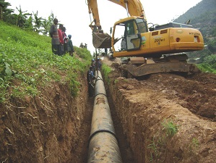
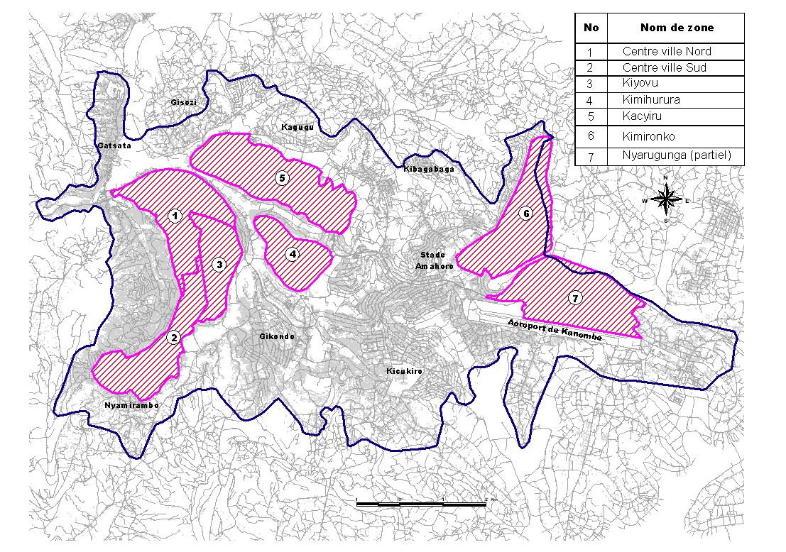
Water & Sanitation: Investments
Kigali Water Network
Value of projects: USD 50m
Incentives:
Rehabilitation and extension of Kigali distribution network
Current losses exceed 40%, strong imperative to resolve the issue and simultaneously meet the pace of growing demand
Way forward:
PPA model, followed by WPA negotiations.
Feasibility Study Required
Kigali Centralized Sewer System
Value of projects: USD 95m
Incentives:
Forms an important part of the Kigali Master Plan.
High requirement for investment due to fast growth of city.
Government supported by European Investment Bank
Way forward:
Project detail design( scopping and sizing) to be completed in May 2014, followed by FBOT model (finance, build, operate and transfer).

Slide 15
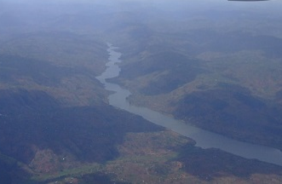
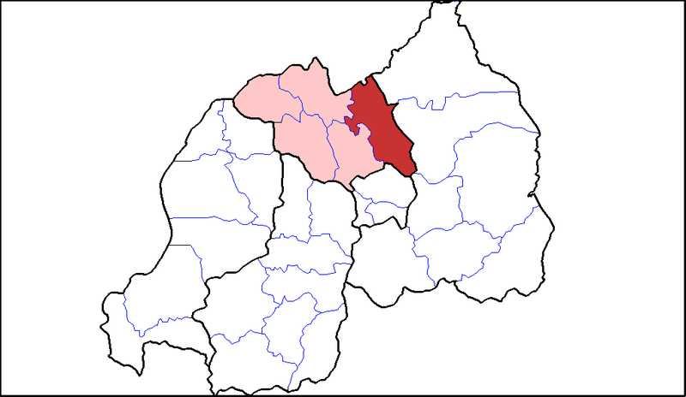
Mutobo Project
Value of projects: USD 300m
Incentives:
Target: to increase water supply in Kigali to 120,000 m3/day by using water from Lake Mutobo.
Feasibility study available
Government support through concessions and other mechanisms will be available to ensure project is financially attractive.
Way forward:
Competitive process for PPP..
Gicumbi Water supply system
Value of projects: USD 17.5m
Incentives:
New water system in Gicumbi for supply of 12,000 m3/day
Way forward:
A PPP model, followed by WPA negotiations.

Slide 16
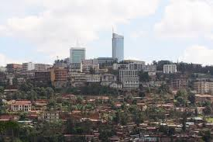
Housing & Urban Planning Sector
Progress and Statistics
Proportion of people living in towns and cities has increased from 17.6% June 2014 from 14.8% in 2010
Kigali City Master Plan completed 2013
National Framework for Secondary cities
21/30 implementation studies for 6 secondary city Master Plans
19% of population have migrated in last 5 years – high urbanisation potential
Tin roof’s for majority of households in entire country
Targets by 2020:
Proportion of people living in 35%
Development of the 6 secondary cities
Investment Facilitation
Most models follow Public Private Partnership
Various incentives on a project-by-project basis e.g.
  Financial
  Service infrastructure

Slide 17
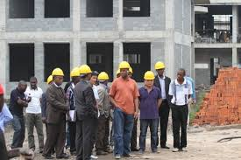
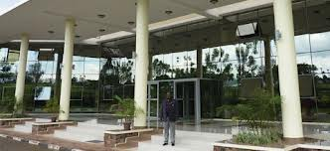
Housing & Urban Planning: Investments
Ministerial Office Complex
Feasibility Study On-going
Value of projects: USD 26m
Incentives:
Construction of government building for 5 ministries and their agencies, this is due to high rental costs at present
Capacity of 42,000 m2 (and scope for enlargement)
2 potential sites already identified in Kigali
Way forward:
Architecture design needs to be updated dependant on sites that will be selected
PPP model
Currently being advertised in local papers
Feasibility Study Required
National Archives
Value of projects: USD 6.2m
Incentives:
Need for a national archive service due to temporary and inadequate nature of current accommodation.
Capacity of 8000 m2
Way forward:
Not yet at development stage as studies and plans required

Slide 18
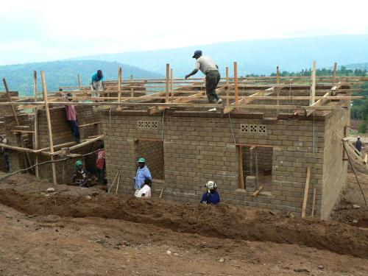
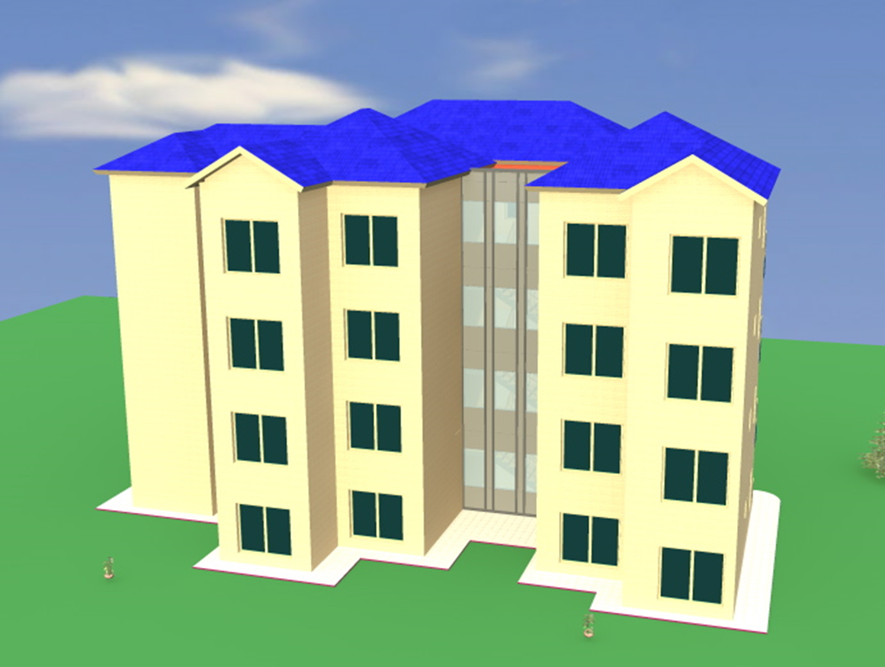
Affordable Housing
Feasibility Study Required
Value of projects: Est. USD 35m per 1000 units
Incentives:
Affordable Housing Development Study by EU found annual demand in Kigali city alone is 30,000 units
Total need for affordable housing is 186,163 in Kigali
Site servicing basic infrastructure to be provided by government
Variety of sites identified and awaiting final approval by May 2014,
Way forward:
Housing cooperatives have been formed to jointly develop housing
Affordable housing management currently being established in RHA
Investment incentives schemes to be agreed with MINECOFIN
Sample Opportunity: Affordable Housing Pilot Project
Value of projects:
Incentives:
4 blocks of accommodation, making 128 units
Located in Kicukiro District on 1 ha
Architectural design is available and plot servicing is on-going
Way forward:
PPP model proposed.

Slide 19
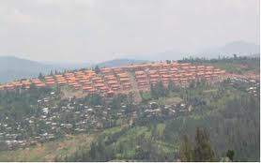
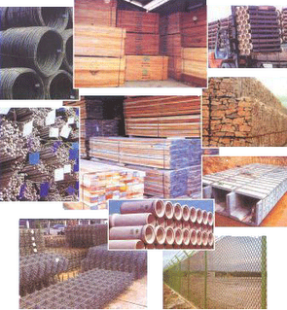
Feasibility Study Required
Urban Site servicing in 6 secondary cities and Kigali with public infrastructure and utilities
Value of projects: USD 4.6 m
Incentives:
Promote well managed and distributed economic development
Government focus on creating ‘secondary cities’
Way forward:
163km road grading implemented so far, and more is required
Increase of local production of construction materials
Value of project: TBC by nature of project
Incentives:
Variety of local industries required: Construction machine parks, quarries (stone, sand, lime etc), wall material production (panels, strawtech, aerated concrete blocks etc)
Cement factories: est US 75m for a clinker plant - one interested party
Cement blocks: est US 2m - investor looking for partner.
Prefab-house factory: est US 7.5m for 500 units per month
Way forward:
Strawtech panel factory under development
PPP models and private models
Feasibility studies for factories etc required
Feasibility Study Required

Slide 20
Regional Integration

Slide 21
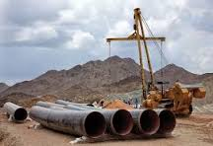
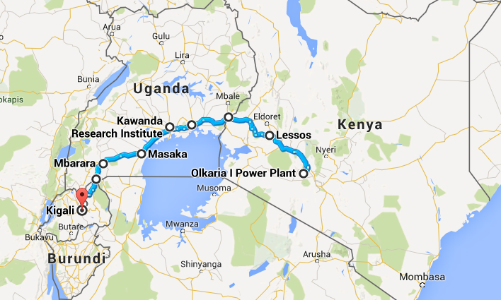
Regional Integration: Investments
Eldoret – Kampala – Kigali Oil Pipeline
Value of projects: USD 402m estimate for Kampala- Kigali section
Incentives:
Eldoret – Kamapala feasibility study finished
Kampala–Kigali feasibility study underway, with final output expected in June 2014
Strong incentive to undertake project for energy security and regional integration
Feasibility study completed
Way forward:
Envisage PPP model
Feasibility Study On-going
Kenya-Uganda-Rwanda 400kV Power Transmission Line
Value of projects: USD 116Mi Rwanda section (370Mi entire project)
Incentives:
Accelerate power exchange trade in the region for 500MW (860km)
Feasibility studies are on-going to be completed in September 2015
Joint monitoring mechanism in place
Way forward:
Complete studies
Mobilise financing

Slide 22
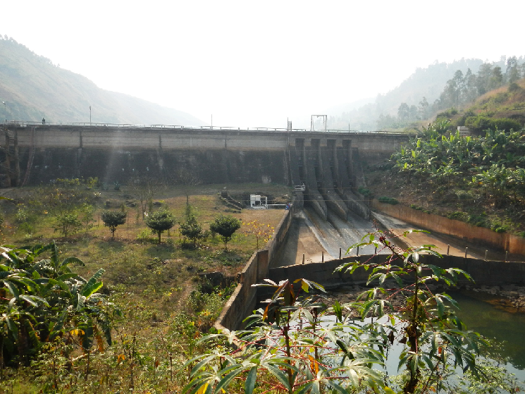
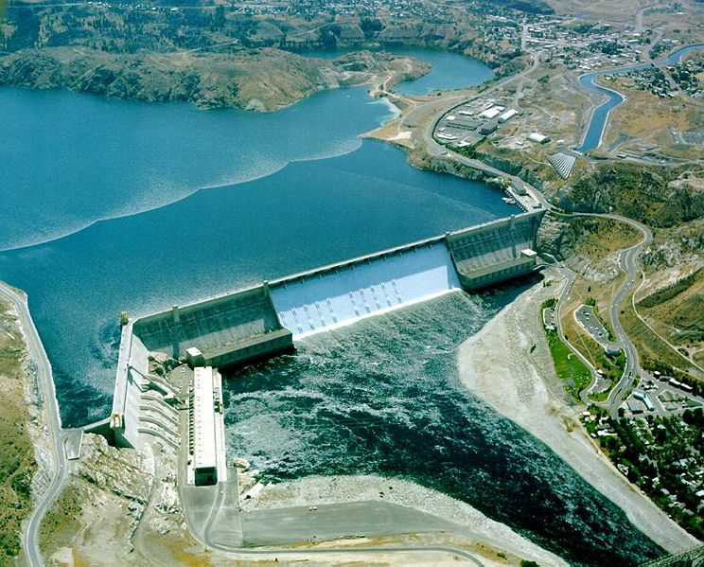
Feasibility Study On-going
Hydro power: Rusizi III
Value of projects: USD 652m
Incentives:
Generation of 145MW Hydro Power Plant
Strong political drive due to Rwanda, Burundi, DRC partnership
Feasibility study completed for Rusizi III
Way forward:
Rusizi III under negotiation but still approachable
Hydro power: Rusizi IV
Value of projects: USD 652m
Incentives:
Generation of 285MW Hydro Power Plant
Strong political drive due to Rwanda, Burundi, DRC partnership
Pre-feasibility study completed
Way forward:
Feasibility study to be implemented
Investors to be identified

Slide 23
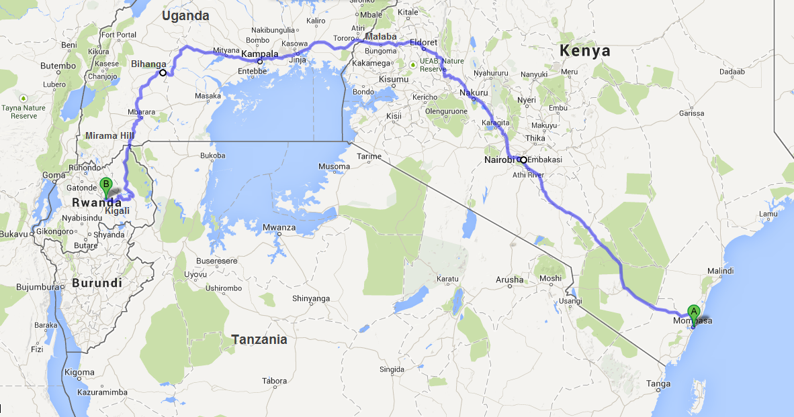
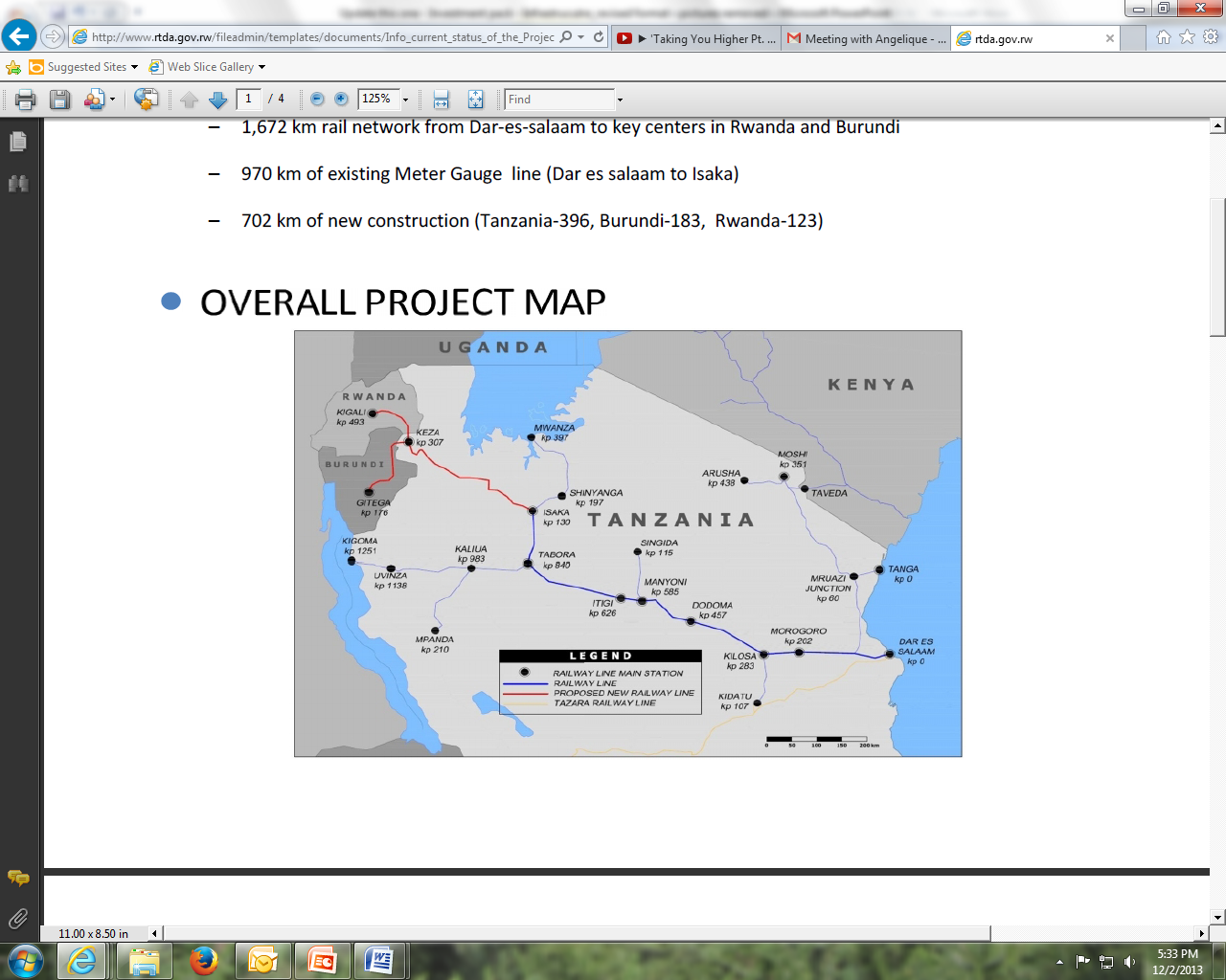
Feasibility Study On-going
Mombasa-Kampala-Kigali Railway
Value of projects: USD 1.5bn Rwanda section (13.5bn entire project)
Incentives:
Mombasa to Nairobi section launched in November 2013
Feasibility studies are on-going for sections from Nairobi to Kigali
A financing source has already been approached, another pending
Way forward:
Complete studies
PPP model
Dar Es Salaam Isaka-Kigali Railway
Value of projects: USD 1.07bn Rwanda section (5.2bn entire project)
Incentives:
Feasibility study suggests growth of freight from 2.9 – 13.5 million tonnes (2014-2044).
IRR estimated at roughly 31%
Transaction Advisor recruited
Request for Expression of Interest completed and companies shortlisted
Way forward:
PPP model

Slide 24
THANK YOU

