Slide 1
PRODUCT Conformity assessment in Tanzania
Single window in Mozambique
20 September 20.09.2016 Awex Brussels
By Peter van Blanckenberg, Sales Executive PCA
GIS SGS Belgium NV

Slide 2

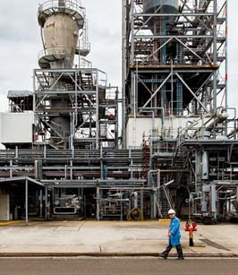
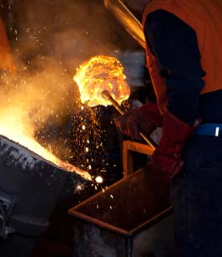


AT A GLANCE
Nº1
WORLD LEADER
85,000
EMPLOYEES
1,650
OFFICES AND LABORATORIES
14
GLOBAL INDUSTRIES
GLOBAL
SERVICE
LOCAL
EXPERTISE

Slide 3




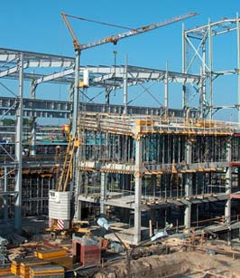



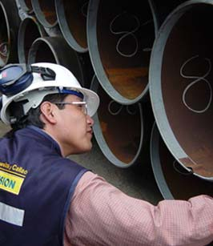






AGRICULTURE AND FOOD
AUTOMOTIVE
AVIATION
CHEMICAL
CONSTRUCTION
CONSUMER GOODS AND RETAIL
ENERGY
FINANCE
INDUSTRIAL MANUFACTURING
LIFE SCIENCES
LOGISTICS
MINING
OIL AND GAS
PUBLIC SECTOR

Slide 4
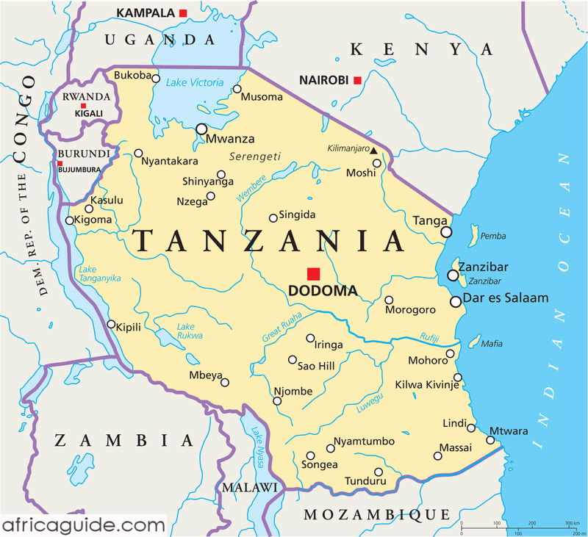
Tanzania

Slide 5
PCA: Product Conformity assessment
What is it about ?

Slide 6
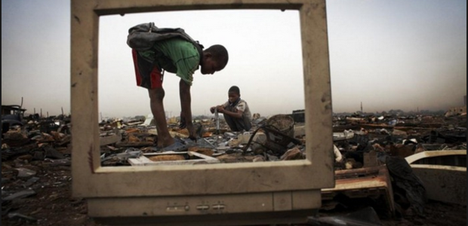

Slide 7
PCA or PVOC ?
Pre shipment verification of Conformity
Controlled by the
Tanzania Bureau of Standards (TBS)
January 1, 2012
Fine of 15% of the CIF value , when not adhering !

Slide 8
What is your route ?
Route A – for unregistered products,
Route B – for registered suppliers or manufacturers of goods.
fast track certification process.
frequent shipments of homogenous products
random inspection/less administration
Route C – licensed products for: manufacturers
the existence of a quality management system in the manufacturing/production process.
the audit of the QMS and licensing of products

Slide 9
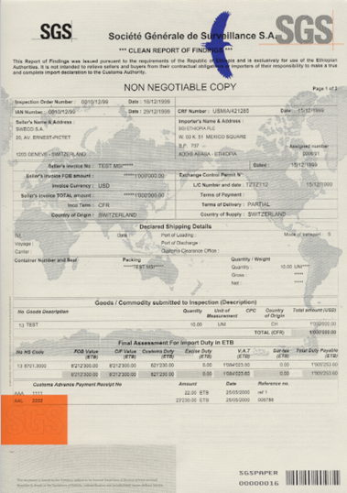
PARTIES / ACTIVITiES
Applicant
Product Information / Request for Certification
Certification Body
(SGS)
Product Experts (evaluation and analysis)
Certification Manager
(Decision to certify)
Accredited
Laboratory
Test Report
Audit Report
Inspection & Certification Body
Inspection Report

Slide 10
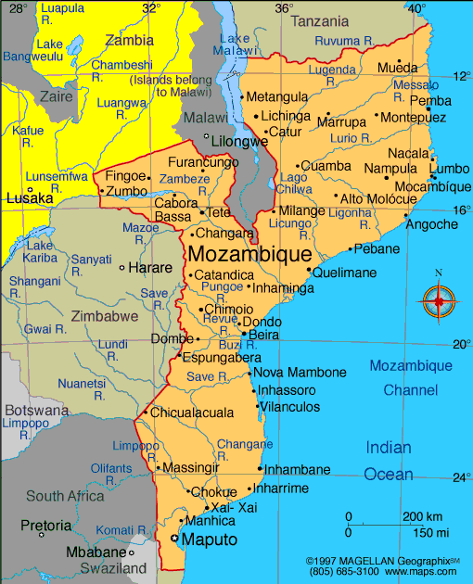
Mozambique

Slide 11
PSI : Preshipment inspection
Initiated by the importer
Checking of the invoice amount and the declared cargo
Checking Custom codes
Inspection and sealing

Slide 12
Single window
A new generation of Single Window building on 15 years of SGS experience in this domain.
Mozambique Community Network (MCNet) was created to implement the national Single Window and mandated SGS to ensure the successful roll out and operations of the project.
This Single Window and Customs Management System package went live in 2012 and now provides a full supply chain management solution throughout the country
Mozambique is now benefiting from the latest developments in transit management, international connectivity and Business Intelligence in addition to the customised Customs Management System and base Single Window functionalities

Slide 13
McNet
https://tradenet.mcnet.co.mz/mtn/jsf/login/MOZTNLoginPage.jsf

Slide 14


Slide 15

Karibu ! Bem vindo !

Slide 16
Koen Vanheusden
°26.06.1962 +12.09.2016

Slide 17
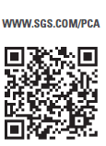
Thank you for your kind attention!
Peter van Blanckenberg, Sales Executive GIS
      peter.vanblanckenberg@sgs.com
      SGS Belgium NV www.sgs.com

