Slide 1
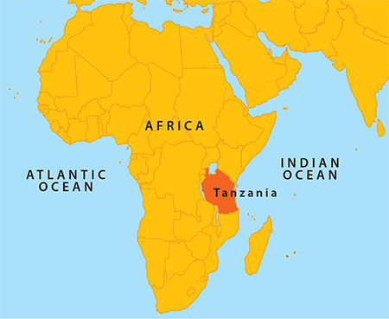
Tanzania
Business mission November 2016

Slide 2
Belgium Tanzania 2015
EUROSTAT -EU Trade TANZANIA Statistics (Imports - Exports)
Reporter(s) / Partner(s): EU28 / Tanzania, United Republic of
Product(s): All products
Year(s): 2015
Indicators | Import Value to the EU/MS (EURO) | Export Value from the EU/MS (EURO) | Total (EURO)
Partners | Tanzania, United Republic of | Tanzania, United Republic of | Tanzania, United Republic of
Years | 2015 | 2015 | 2015
Reporters
Belgium | 178,499,693 | 144,387,488 | 322,887,181
Germany | 141,473,802 | 120,253,657 | 261,727,459
United Kingdom | 39,187,368 | 165,404,717 | 204,592,085
France | 36,283,099 | 160,637,694 | 196,920,793
Netherlands | 64,767,649 | 122,997,338 | 187,764,987
Italy | 39,283,072 | 91,383,881 | 130,666,953
Sweden | 5,630,593 | 79,734,692 | 85,365,285
Ireland | 53,021,609 | 17,214,718 | 70,236,327
Spain | 23,850,890 | 29,544,687 | 53,395,577
Poland | 27,547,394 | 22,357,689 | 49,905,083
Finland | 4,875,565 | 27,078,024 | 31,953,589
Portugal | 26,042,580 | 4,714,120 | 30,756,700

Slide 3
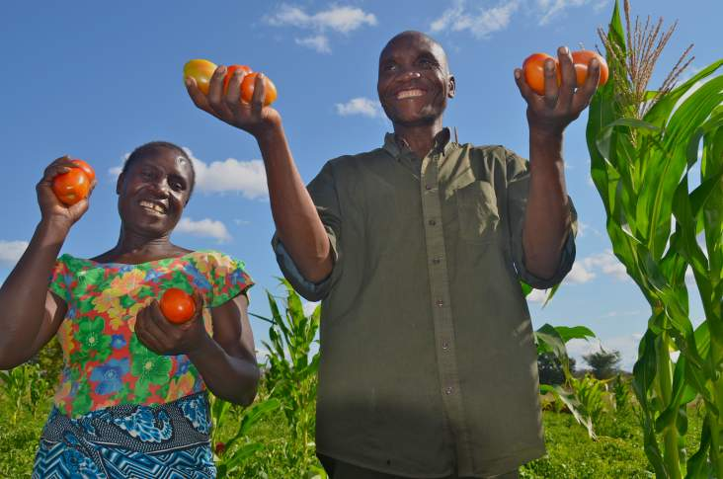

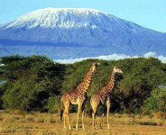

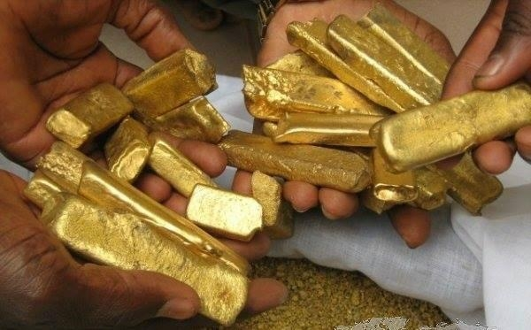
The economy of Tanzania is sustained by
The agriculture sector,
ICT sector,
The tourism sector,
Energy
The extraction industry
Others

Slide 4
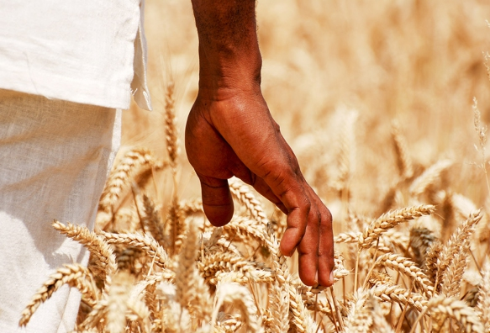
Agriculture
              Accounts for: 25% of the GDP, Provides 95 percent of food requirement, Employs 75 per cent of the population
Crops like corn, cassava, sweet potatoes, beans, bananas, millet, tobacco, coffee, tea, cashew nuts, sisal and cotton.
Meat production: 55% comes from cattle, 21% from sheep and goats, 14% from pigs, and 10% from chicken
Fisheries : 64 000 KM² of Marine water, 223.000 KM² of EEZ & 58.000 KM² of wetlands. Production =+/- 800.000 metric tons
Opportunities : Farming, Agro-processing, Tools machinery, Fertilisers, Education, Logistics, Packaging, to mention a few

Slide 5

ICT
National ICT Backbone (NICTBB)
Mobile phone subscribers up by 25 pct in 2015
Operators : 12,7 million with Vodacom (S.A.), 11,1M with Tigo (Sweden) 11M with irtel (India), Zantel (UAE) 1,8M mainly in Zanzibar and 1,2M with Halotel (Vietnam). 39M subscribers out of 50M people.
Internet penetration: 17M users most wireless.
Opportunities : Mobile money, applications for farming, E-learning, etc

Slide 6
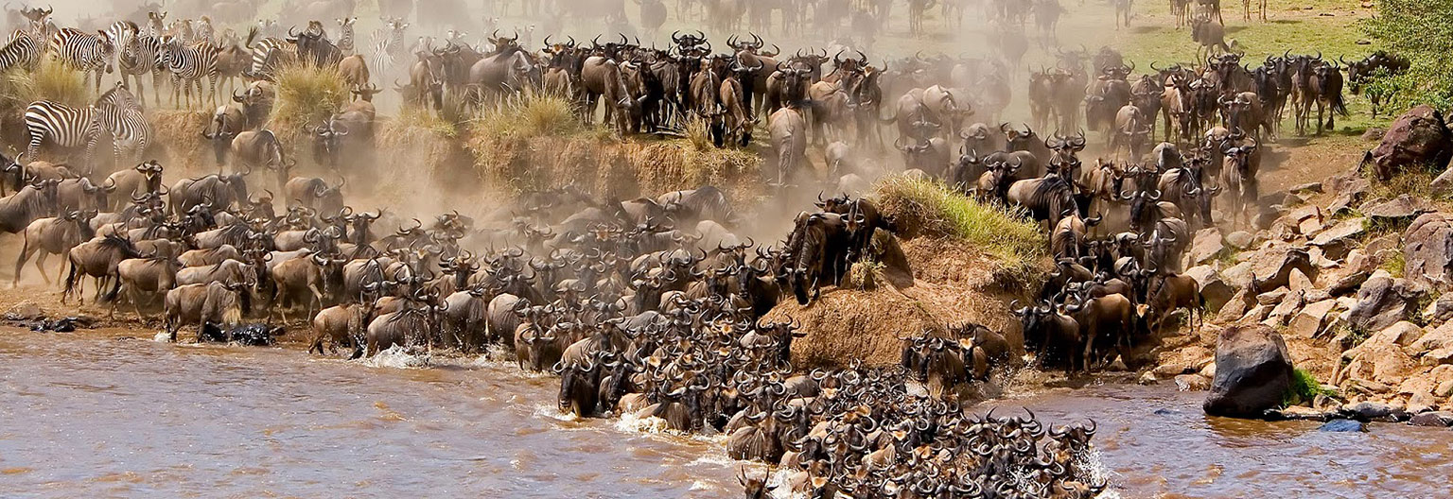
Tourism
Employs over 10 percent of the total work force of Tanzania and generates 5% of the GDP
Around 1,15M tourists in 2015 expected to reach 1,63 in 2025
Opportunities: Horeca, travel, insurance, infrastructure

Slide 7
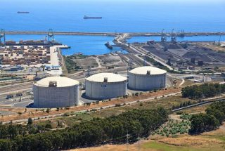
Energy - LNG
In Q1 2016 an additional 2.7 trillion cubic feet (tcf) of natural gas deposits raised Tanzanias estimated recoverable natural gas reserves to 57 tcf (1,6 trillion m³).
All major international players are there
USD 10 to 20 billion investment is projected for exploration and production in the coming decade.
Sumitomo/Mitsubishi/Toshiba(Japan
re building a 245MW for 2018 a natural gas-fired power plant in Kinyerezi II (30kms south of Dar Es Salaam). Kinyerzi I has already 70MW on grid
Symbion and Ubungo II, which previously ran on expensive A1 jet fuel, were able to switch to cheaper, clean natural gas. The 180 MW of electricity generated by these plants is cleaner and more sustainable as a result.
Opportunities in equipment, supply chain, logistics, drilling, piping, construction, port infrastructure, finance, transport, power and so many more.

Slide 8

Energy: ELECTRICITY
Tanzania has 1486MW on 4,869 km of transmission lines at 220 kV, 132 kV, and 66 kV. Tanesco is Tanzania’s main Electricity operator with 1.8 million customers and a target of 5 million connected customers by 2022.
550MW is Hydro, 650MW is Gas and 300MW Oil.
Tanzania is suffering from chronic power shortages due to a decline in hydroelectric power generation.
Opportunities: Any power related equipment, small power projects, green energy, electrification, distribution, consultancy, generators

Slide 9
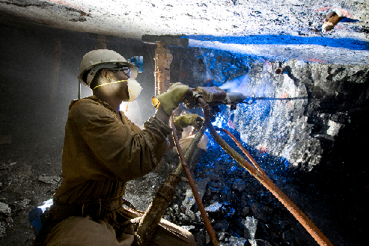
Mining
In 2015 Tanzania’s exports amounted to 4,535 BillionTZS (1,9 Bil€) with Gold representing 2,717 BTZS and Diamonds 65 BTZS.
Mining in Tanzania includes metals (gold, iron ore, nickel, copper, cobalt, silver), industrial minerals (diamond, tanzanite, ruby, garnet, limestone, soda ash, gypsum, salt, phosphate, gravel, sand, dimension stones and lately graphite), and fuel minerals (coal, uranium).
Mining and quarrying activities in Tanzania contributed 3.7% to its GDP with USD 1.78bn in 2014, compared to only USD 598m in 2009, representing a value increase of almost 200%.

Slide 10

Others
Basically all segments present opportunities: water, health, education, industrialisation, services, automotive, chemicals, pharmaceuticals, tools machinery, entertainment, banking, construction, real estate, airplanes and others.
Opportunities also mean : Investment – Funds – Risks – Time – information – Commitments – Patience – Rules & Licencing - Flexibility and strategies

